Slide 1


Sales Analyzing and Weekly Sales Forecasting
Rossman
Yang Liu Kunz
Notes:
This is the second capstone I finished in Nov, it's a binary classification problem. The dataset was obtained from kaggle, provided by a training institute that provides training service in data science and analytics area. They have large number of enrollees sign up for training, then they started thinking maybe they can expand their business in recruiting because they can conenct the enrollees who are open to a new job with their clients who are hiring. So, they want to build a model that can help them detect the target enrollee or we can call them potential candidate, by analyzing the enrollees' credential, demographics, experience related data that they collected from the platform.

Slide 2

TOC
Overview
Dataset description
Data Wrangling
Key Findings
Modeling
Model Evaluation
Model Deployment
Summary and Recommendation
Appendix
Notes:
This presentation is based on the assumption that if I was a member on the data science team of this training institute, how would I solve this business problem by building a model that can help them achieve their marketing KPI with better cost performance. As I have a background of working as an account manager in digital marketing industry, so I wanted to apply my previous experience to this project.

Slide 3
Overview
The aim of this project:
Explore and analyze historical sales related data for Rossmann.
Identify the key factors that influence store sales.
Provide overall sales performance report to the management team with feasible strategies to increase future sales.
Provide individual store performance report to each store manager.
Develop time series model that predict the future sales for each store with certain level of accuracy.
Notes:
Therefore, even though it is not a part of Kaggle competition, but I set up a practical marketing goal for the recruiting team in this project,
And the KPI was set as: reach out to more than half of the Target enrollees from the dataset with the lowest financial cost.
So here in this case, we not only need a certain amount of reach but also need to minimize the cost we spend on reaching to each Target enrollee

Slide 4
Dataset 1 train.csv
1,017,209 data samples
9 variables (7 num, 2 cat)
Date: 2013/01/01 ~ 2015/07/31
Column Name | counts | unique_value_pct | nan_pct | data_type
Sales | 21734 | 2.14 | 0.0 | int64
Customers | 4086 | 0.40 | 0.0 | int64
Store | 1115 | 0.11 | 0.0 | int64
Date | 942 | 0.09 | 0.0 | object
DayOfWeek | 7 | 0.0007 | 0.0 | int64
StateHoliday | 5 | 0.0005 | 0.0 | object
Open | 2 | 0.0002 | 0.0 | int64
Promo | 2 | 0.0002 | 0.0 | int64
SchoolHoliday | 2 | 0.0002 | 0.0 | int64
StateHoliday: a = public holiday, b = Easter holiday, c = Christmas, 0 = None
Notes:
So the dataset contains 18,359 observations of 14 variables, and 10 of them are categorical variables, 4 of them are categorical variables. And after exploring the variables I realized I can group them into 6 groups:

Slide 5
train.csv (head5)
Notes:
So the dataset contains 18,359 observations of 14 variables, and 10 of them are categorical variables, 4 of them are categorical variables. And after exploring the variables I realized I can group them into 6 groups:

Slide 6
Dataset 2 store.csv
1115 data samples
10 variables (7 num, 3 cat)
Colum Name | counts | unique_value_pct | nan_pct | data_type
Store | 1115 | 100.00 | 0.0000 | int64
CompetitionDistance | 654 | 58.65 | 0.27 | float64
Promo2SinceWeek | 24 | 2.15 | 48.80 | float64
CompetitionOpenSinceYear | 23 | 2.06 | 31.75 | float64
CompetitionOpenSinceMonth | 12 | 1.08 | 31.75 | float64
Promo2SinceYear | 7 | 0.63 | 48.80 | float64
StoreType | 4 | 0.36 | 0.0000 | object
Assortment | 3 | 0.27 | 0.0000 | object
PromoInterval | 3 | 0.27 | 48.80 | object
Promo2 | 2 | 0.18 | 0.0000 | int64
Notes:
So the dataset contains 18,359 observations of 14 variables, and 10 of them are categorical variables, 4 of them are categorical variables. And after exploring the variables I realized I can group them into 6 groups:

Slide 7
store.csv
Notes:
So the dataset contains 18,359 observations of 14 variables, and 10 of them are categorical variables, 4 of them are categorical variables. And after exploring the variables I realized I can group them into 6 groups:

Slide 8
Data Processing

Slide 9
combined_data.csv
Notes:
So the dataset contains 18,359 observations of 14 variables, and 10 of them are categorical variables, 4 of them are categorical variables. And after exploring the variables I realized I can group them into 6 groups:

Slide 10

Key Findings
Notes:
In this section we will introduce the key findings we had after exploring the relationship between the predictors and our response variables

Slide 11
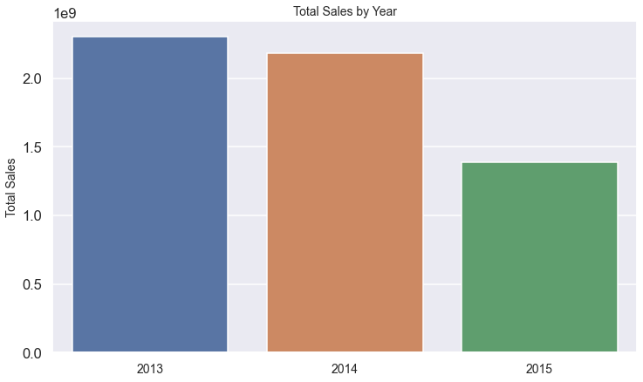
Year | Total Sales | Percentage Change
2013 | 2.303E+09 | NaN
2014 | 2.181E+09 | -5.3%
2015 | 1.389E+09 | -36.3%
*Please be notified that the total sales of 2015 are not a full year data
*Total sales decreased 5.3% in 2014 as 180 stores were closed for
renovation for a few months
Total Sales by Year

Slide 12
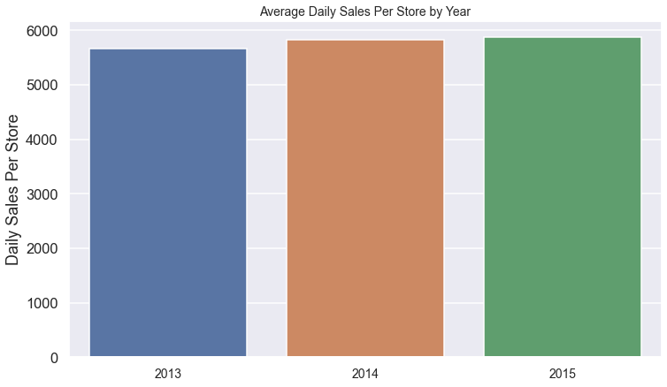
Year | Daily Sales Per Store | Percentage Change
2013 | 5,659 | NaN
2014 | 5,833 | 3.1%
2015 | 5,878 | 0.7%
Daily Sales Per Store by Year

Slide 13
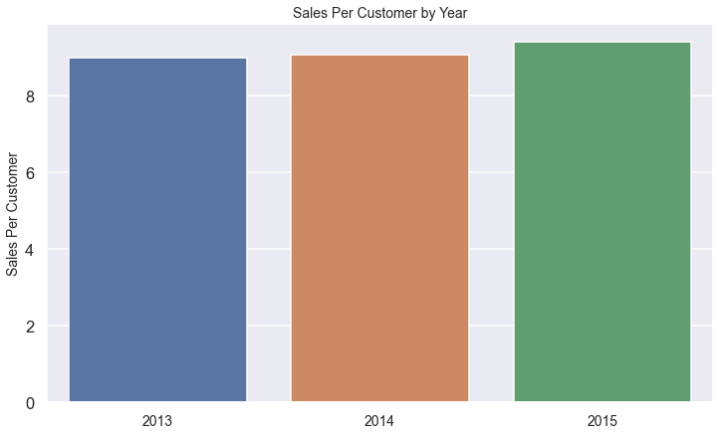
Year | Sales Per Customer | Percentage Change
2013 | 8.995 | NaN
2014 | 9.068 | 0.8%
2015 | 9.417 | 3.8%
Sales Per Customer by Year

Slide 14
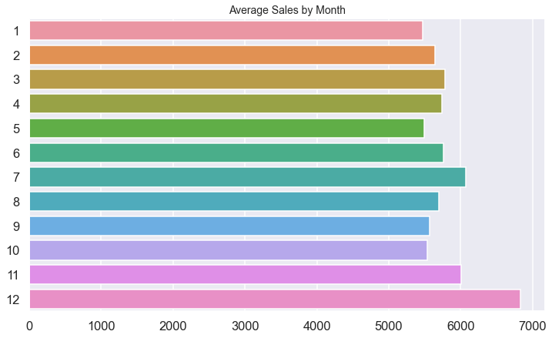
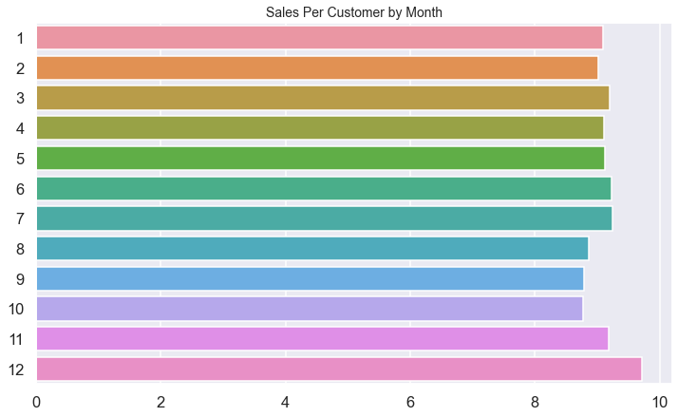
December and July have the highest and second highest daily sales per store
December and July have the highest and second highest sales per customer
Average Sales by Month

Slide 15
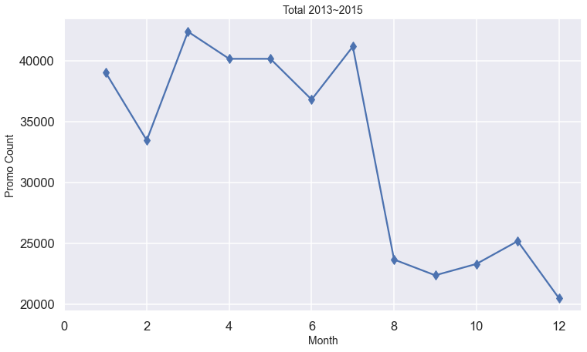
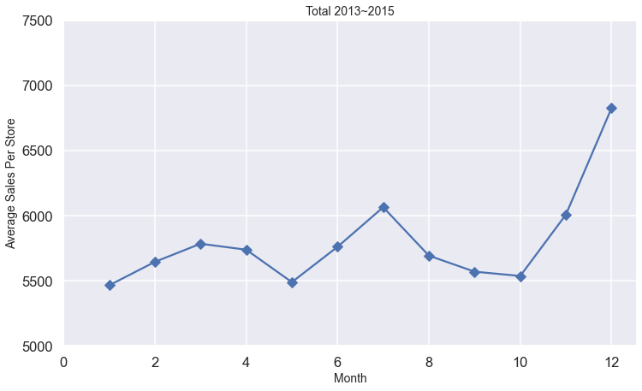
July has the highest promotion counts in summer season. This strategy positively affected average daily sales per store in July. Also, we can see winter and autumn seasons are the off seasons of our business.
Promotion by Month

Slide 16
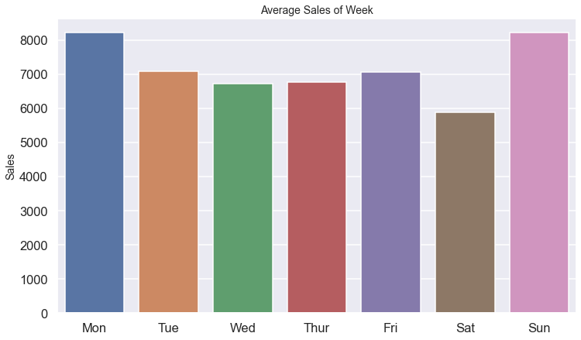
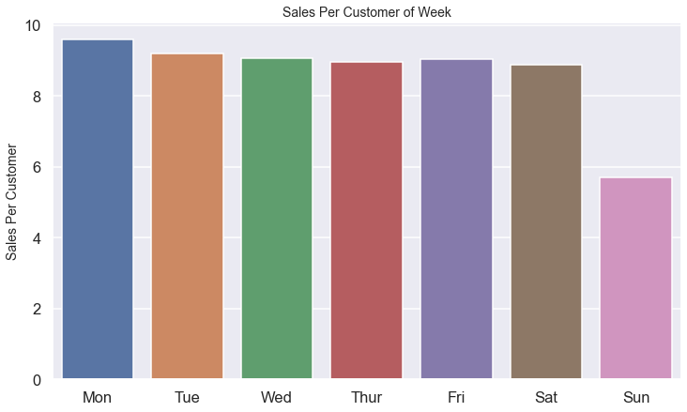
Sunday has the second highest daily sales (per store) in a week, but its sales per customer is the lowest.
(possible reason: no promotion on the weekend, too crowded in the store on Sunday)
Average Sales by Day of Week

Slide 17
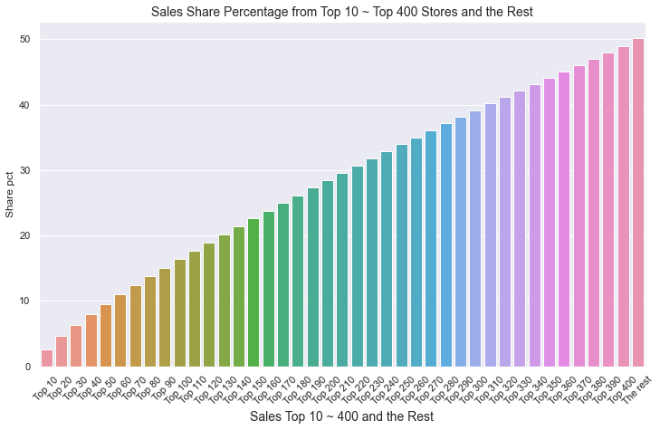
Ranking | Store id | Sales | Percentage %
1 | 262 | 19,516,842 | 0.332304
2 | 817 | 17,057,867 | 0.290437
3 | 562 | 16,927,322 | 0.288214
4 | 1114 | 16,202,585 | 0.275874
5 | 251 | 14,896,870 | 0.253642
6 | 513 | 14,252,406 | 0.242669
7 | 788 | 14,082,141 | 0.23977
8 | 733 | 14,067,158 | 0.239515
9 | 383 | 13,489,879 | 0.229686
10 | 756 | 12,911,782 | 0.219843
 |  | Total Percentage | 2.60
Top 400 stores and the rest 715 stores’ sales shares are roughly about 1:1.
Half of the total sales (5.873 billion over 942 days) came from the top 400 stores and the rest 751 stores generated the other half.
Total Sales Share Break Down by Stores

Slide 18
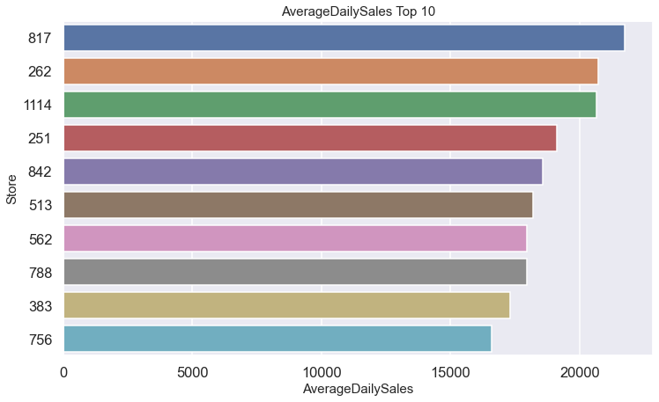
Store id | Sales Per Customer Ranking
817 | 1049
262 | 1099
1114 | 1081
251 | 919
842 | 1
513 | 717
562 | 1103
788 | 367
383 | 909
756 | 1038
Stores which has top 10 highest average daily sales, tend to have very low value of sales per customer
Average Daily Sales Top 10

Slide 19
Store842 has the highest value of sales per customer but it didn’t rank in the top 10 total sales.
As we can see from the left graph, store 842 stayed closed for half year due to renovation.
Store262, Store817 has the highest and second highest value of total sales.)
Store842 Weekly Sales

Slide 20
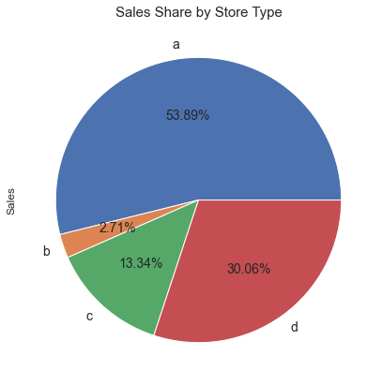
Store Type | Count | Total Sales
a | 602 | 3.16E+09
d | 348 | 1.77E+09
c | 148 | 7.83E+08
b | 17 | 1.59E+08
A type has the highest value of store count, and total sales share
Sales by Store Type

Slide 21
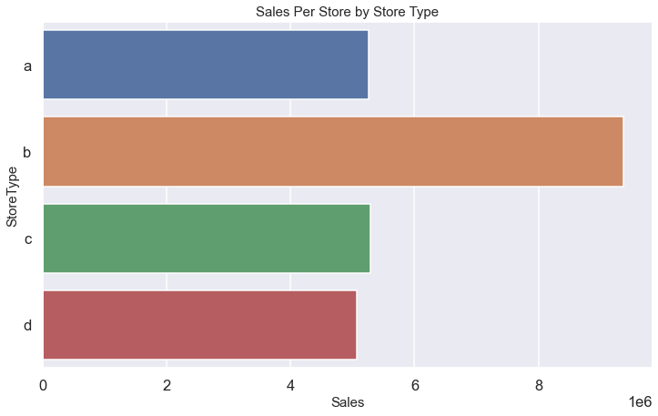
Store Type | Total Sales Per Store
a | 5.26E+06
d | 5.07E+06
c | 5.29E+06
b | 9.37E+06
B type has the highest value of total sales per store
Sales by Store Type

Slide 22
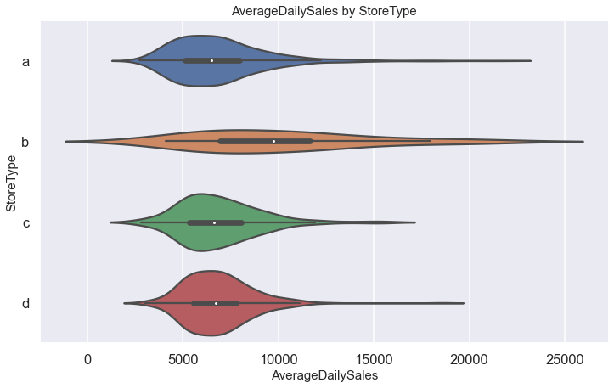
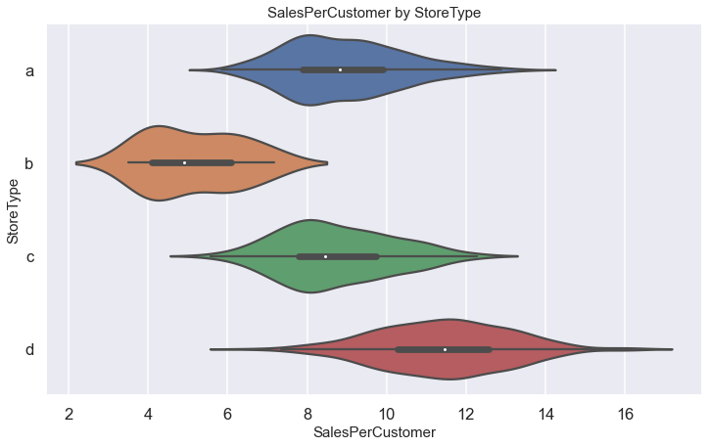
Store Type | Average Daily Sales | Sales Per Customer
a | 6913 | 8.96
d | 6824 | 11.43
c | 6917 | 8.74
b | 10111 | 5.17
Sales by Store Type

Slide 23
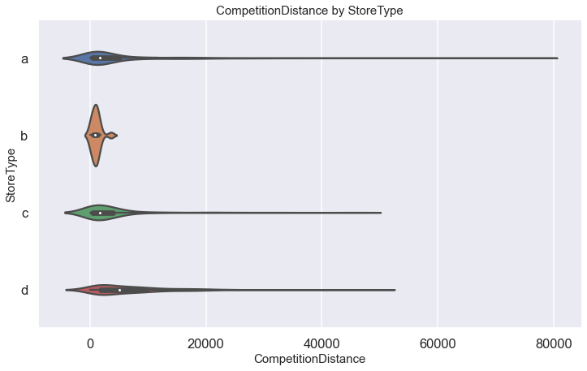
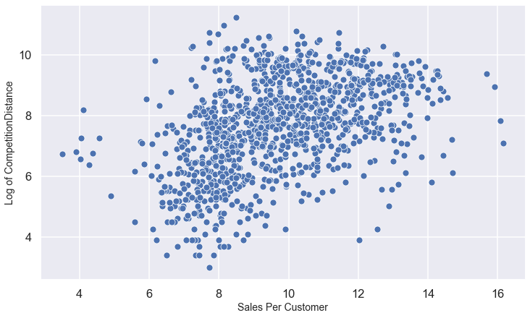
B type stores have competitors more near by comparing to other 3 types.
We observed a liner relationship between the log of competition distance and sales per customer
The log of competition decrease, the value of sales per customer decrease correspondingly.
Competition Distance by Store Type
Notes:
B type average: 1061
A: 5123, C: 3523, D: 6913
B Median: 900
A: 1790, C: 1660, D: 5040

Slide 24
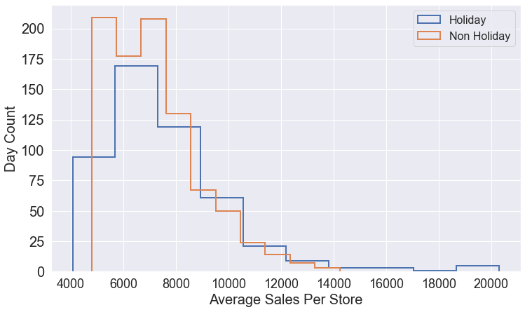
Holiday | Average Daily Sales | Sales Per Customer
Yes | 7614 | 8.59
No | 7208 | 8.53
Holidays (state or school holidays) are affecting the amounts of sales.
When it’s a holiday, average sales per store is 5% higher than when it’s not a holiday
There were more daily sales higher than 14,000 when it’s a holiday.
Holiday and Sales

Slide 25
Modeling & Analysis
Notes:
In this section we will introduce the key findings we had after exploring the relationship between the predictors and our response variables

Slide 26
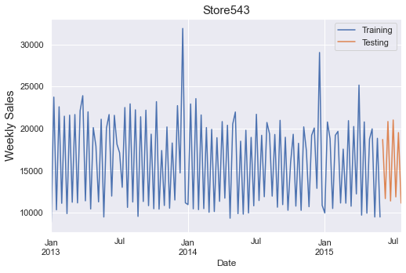
When there’s no zero weekly sales over the 135 weeks, 942 days, we split the dataset following strategy 1
Data Processing and Testing Strategy

Slide 27
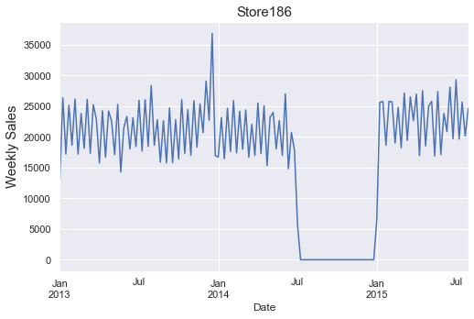
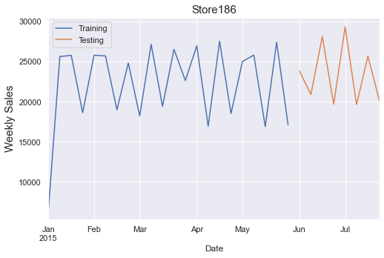
When there’s continuing zero weekly sales over the 135 weeks (stores closed for renovation), we will do the train/test split following strategy 2
Strategy 3: If we don’t have enough data points after the store reopen (less than 16 weeks),
we will then drop the zero values in the time series and do train/test split.
Data Processing and Testing Strategy

Slide 28
MAE
we need a robust model for each store that won’t be influenced by outliers in the time series
WAPE
Check model robustness over 8 weeks of prediction
Baseline model
Mean Method: predict and forecast by using the average of the time series
Model
Auto Arima: generate optimal p,d,q for seasonal and non seasonal time series
Model evaluation metrics
Baseline Model, Model and Metrics selection

Slide 29
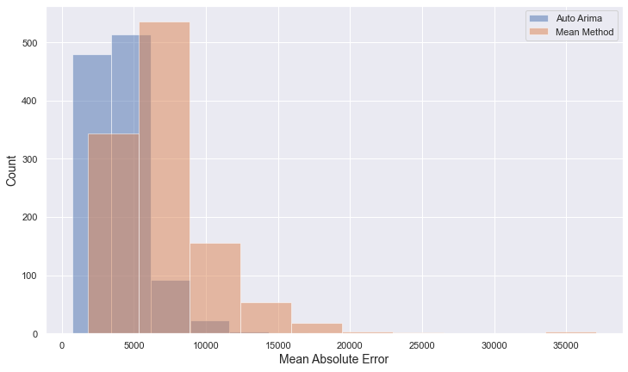
 | MAE_AutoArima | MAE_MeanMethod | Performance Improvement
Average | 4084 | 7143 | 1.75
By comparing the average value of MAE we obtained from 1115 stores, we can see Auto Arima outperformed mean method by 1.75 times.
Model Evaluation - MAE

Slide 30
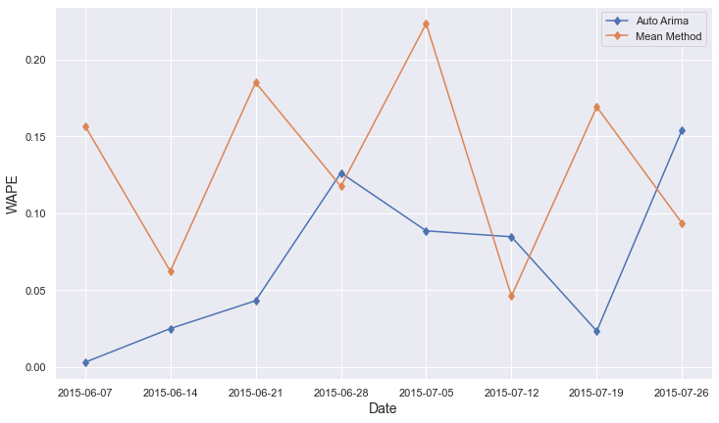
Date | WAPE_AutoArima | WAPE_MeanMethod
2015-06-07 | 0.0030 | 0.1568
2015-06-14 | 0.0249 | 0.0622
2015-06-21 | 0.0430 | 0.1850
2015-06-28 | 0.1262 | 0.1174
2015-07-05 | 0.0885 | 0.2233
2015-07-12 | 0.0846 | 0.0460
2015-07-19 | 0.0233 | 0.1691
2015-07-26 | 0.1542 | 0.0934
We can see from the line plot that within 8 WAPE results, there were 5 of them are showing that Auto Arima model performed better than mean method, except week 6/28, week 7/12 and week 7/26.
Conclustion: Auto Arima model is our final model
Model Evaluation - WAPE

Slide 31
After identifying the best model we used python dash package and deployed the model on Heroku cloud service.
Enabling the store manager to confirm the forecast together with 95% confidence interval and with past 8 weeks sales and prediction values.
Model Deployment

Slide 32
Summary and Recommendation
Notes:
In this section we will introduce the key findings we had after exploring the relationship between the predictors and our response variables

Slide 33
Summary 1
Comparing to 2013, sales in 2014 decreased by 5.3% due to 180 stores closed for renovation. 5 of them ranked in top 10 stores that generated high values of sales per customer.
Try not to close these stores at the same time for renovation in the future if possible. (Store 842, Store 612, Store 52, Store 540 and Store 903).
Recommendation 1
Summary and Recommendation 1

Slide 34
Summary 2
34
Winter and autumn time are the off seasons of our business. They are also the seasons that we didn’t run much daily promotions comparing to summer and winter seasons.
Increase daily promotions in Jan, Feb, Sept and Oct.
Recommendation 2
Summary and Recommendation 2

Slide 35
35
Summary 3
35
Stores that have high average daily sales tend to have low value of sales per customer.
Increase the value of sales per customer for Top 10 stores that have high average daily sales.
Increase the value of sales per customer for B type stores.
Encourage customers to spend more for per visit at these stores.
Recommendation 3
Summary and Recommendation 3

Slide 36
36
36
Summary 4
36
Customers tend to spend less at our stores when competitors are close by
Differentiate our products and customer service from our competitors
Recommendation 4
Summary and Recommendation 4

Slide 37
Seasonality: Make sure our products are right for the season—whether it’s the cold season or allergy season in order to maximize on customer needs and boost their spend. Stock the product before the season hits and have it there when consumers need it
Large Display: Use big displays for seasonal items and redesign our display more frequently to make it more organized and interesting and dynamic with each season or holiday so customers will want to come into the store more often.
Know Our Customer: Conduct customer surveys to find out:
reasons of why customers would choose competitors over us;
what are our customers’ destination purchases vs. impulse purchases, then invest in displays of the former, make sure it’s easy to find and easily called out.
Strategies for Recommendation 3 & 4

Slide 38
Appendix
Notes:
In this section we will introduce the key findings we had after exploring the relationship between the predictors and our response variables

Slide 39
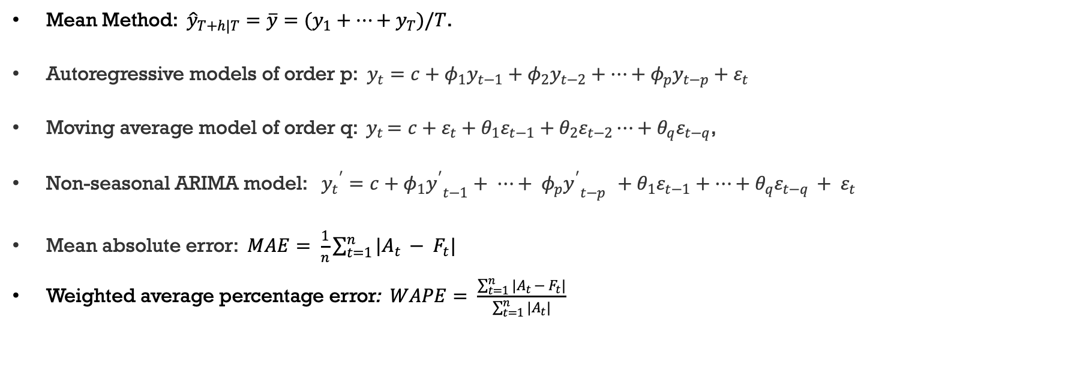
Mean Method: ${\hat{y}}_{T+h|T}=\overline{y}=(y_{1}+⋯+y_{T})/T$.
Autoregressive models of order p: $y_{t}=c+φ_{1}y_{t−1}+φ_{2}y_{t−2}+⋯+φ_{p}y_{t−p}+ε_{t}$
Moving average model of order q: ${ y}_{t }=c+ε_{t}+θ_{1}ε_{t−1}+θ_{2}ε_{t−2}⋯+θ_{q}ε_{t−q}$,
Non-seasonal ARIMA model: ${y_{t}}^{′}=c+φ_{1}{y^{′}}_{t−1}+ ⋯+ {φ_{p}{y^{′}}_{t−p }+θ}_{1}ε_{t−1}+⋯+θ_{q}ε_{t−q }+ ε_{t}$
Mean absolute error: $MAE= \frac{1}{n}\sum_{t=1}^{n}{|A_{t }− F_{t}|}$
Weighted average percentage error: $WAPE= \frac{\sum_{t=1}^{n}{|A_{t }− F_{t}|}}{\sum_{t=1}^{n}{|A_{t}}|}$
Equations

Slide 40
Parameters and value set up for Auto Arima Model

Slide 41
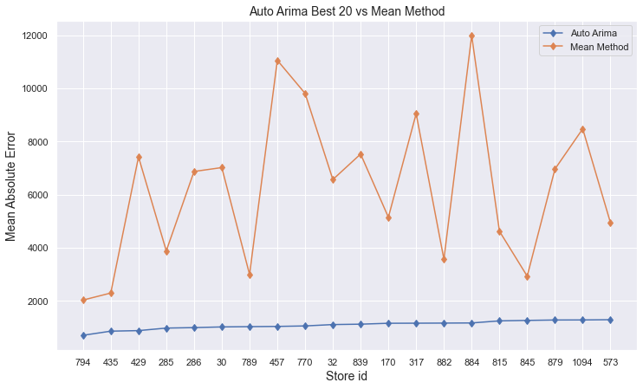
Model Evaluation - Auto Arima Best 20 vs. Mean Method

Slide 42
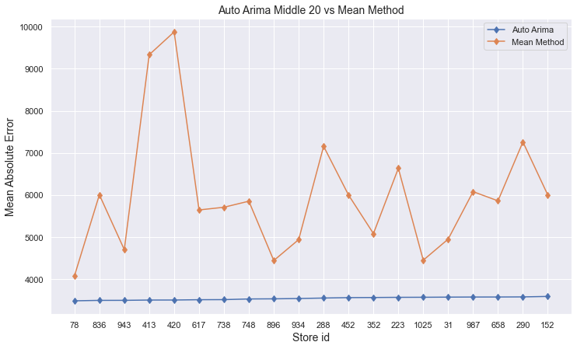
Model Evaluation - Auto Arima Middle 20 vs. Mean Method

Slide 43
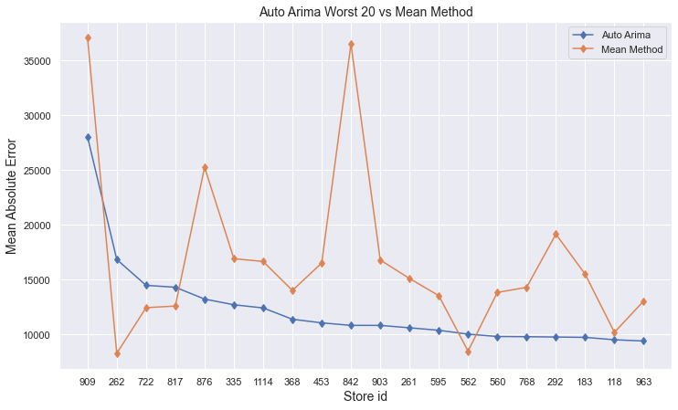
Model Evaluation - Auto Arima Worst 20 vs. Mean Method

Slide 44
References
https://www.kaggle.com/c/rossmann-store-sales/data?select=train.csv (assessed Dec 14, 2020)
https://www.kaggle.com/c/rossmann-store-sales/data?select=store.csv (assessed Dec 14, 2020)
https://towardsdatascience.com/time-series-forecasting-using-auto-arima-in-python-bb83e49210cd , Sushmitha Pulagam (assessed Dec 20, 2020)
Rob J Hyndman, George Athanasopoulos (2018) Forecasting: Principles and Practice, 2nd edition, OTexts: Melbourne, Australia.
https://www.linkedin.com/pulse/reading-acf-pacf-plots-missing-manual-cheatsheet-saqib-ali/ , Saqib Ali (assessed Dec 28, 2020)
https://towardsdatascience.com/introduction-to-aic-akaike-information-criterion-9c9ba1c96ced , Alexandre Zajic (assessed Jan 2, 2021)
https://uhurunetwork.com/business-dashboard/ (assessed Jan 14, 2021)
https://mashmetrics.com/marketing-reports-dashboards-performance-alerts-pros-cons-of-each/ (assessed Jan 14, 2021)
https://machinelearningmastery.com/how-to-develop-baseline-forecasts-for-multi-site-multivariate-air-pollution-time-series-forecasting/ ,Jason Brownlee (assessed Jan 20, 2021)
https://machinelearningmastery.com/time-series-forecasting-methods-in-python-cheat-sheet/ , Jason Brownlee (assessed Jan 20, 2021)
https://machinelearningmastery.com/remove-trends-seasonality-difference-transform-python/, Jason Brownlee (assessed Jan 22, 2021)
https://www.baeldung.com/cs/mape-vs-wape-vs-wmape (assessed Jan 22, 2021)
https://www.thebalancesmb.com/pharmacy-merchandising-how-to-boost-sales-2663853, Amanda Baltazar (assessed Jan 22, 2021)
https://en.wikipedia.org/wiki/Kaggle (assessed Jan 1, 2021)
Springboard – DSC Capstone Project II Detecting Potential Candidates Who are Looking for a New Job ((Nov 2020) Yang Liu Kunz

